Slide 1
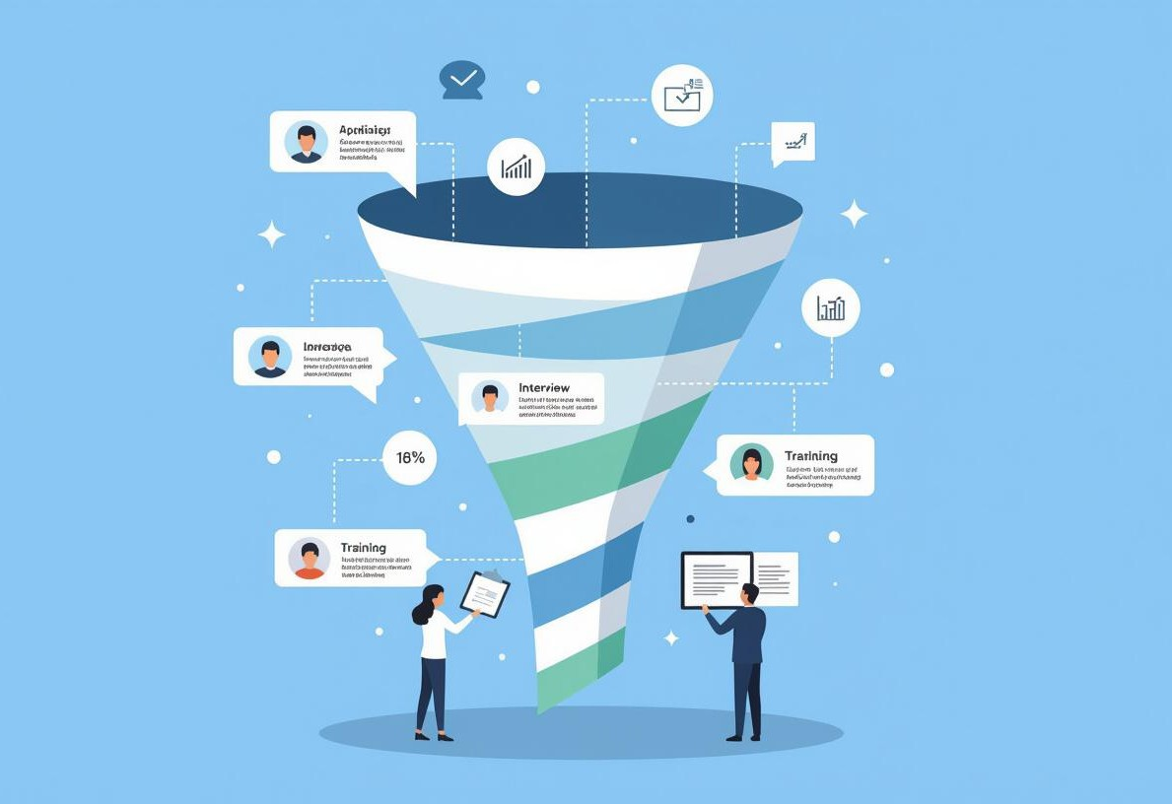
Problem & Motivation
Manual resume screening is a bottleneck in hiring:
Time-consuming: Recruiters spend hours sifting through resumes. Error-prone: Human review misses key details and introduces bias. Inconsistent: Different recruiters interpret resumes differently.
We need intelligent automation to streamline recruitment and unlock candidate potential!

Slide 2

Solution Overview — AI Resume Parser
Our AI Resume Parser is a game-changer:
Automated resume processing: Extracts data from resumes automatically.
Intelligent analysis: Uses AI to understand skills, experience, and qualifications.
Structured data: Converts unstructured resumes into usable data for recruitment systems.
It's the smart way to find the best talent faster!

Slide 3
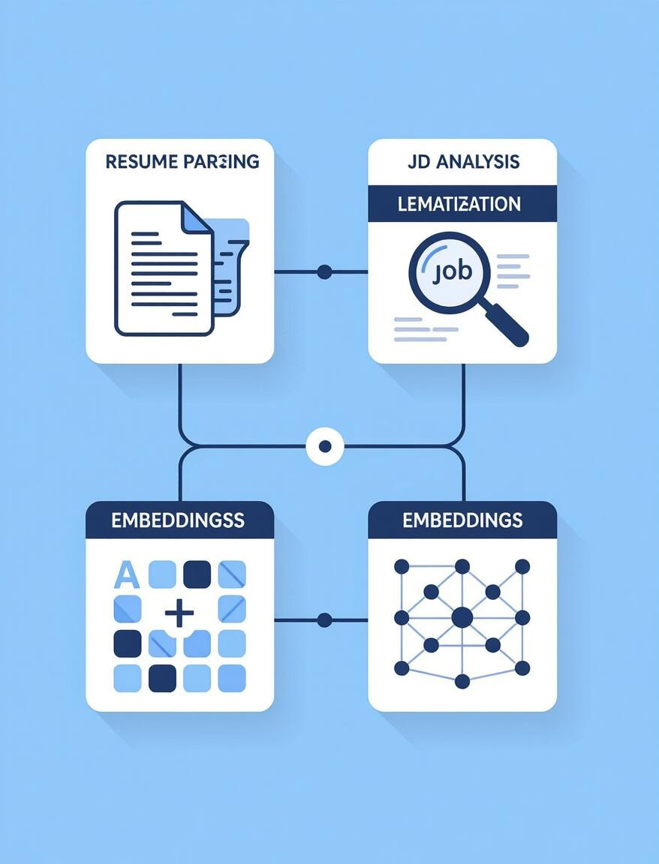
Core Features & Capabilities
Multi-format document support: Handles PDFs, DOCX, TXT, and even images using OCR.
AI-based data extraction: Accurately extracts contact info, work experience, skills, and education.
Intelligent classification: Classifies job roles, industries, and seniority levels.
Data enrichment and standardization: Standardizes skills (e.g., "JS" to "JavaScript") and normalizes data for consistency.
We make resume data actionable!

Slide 4
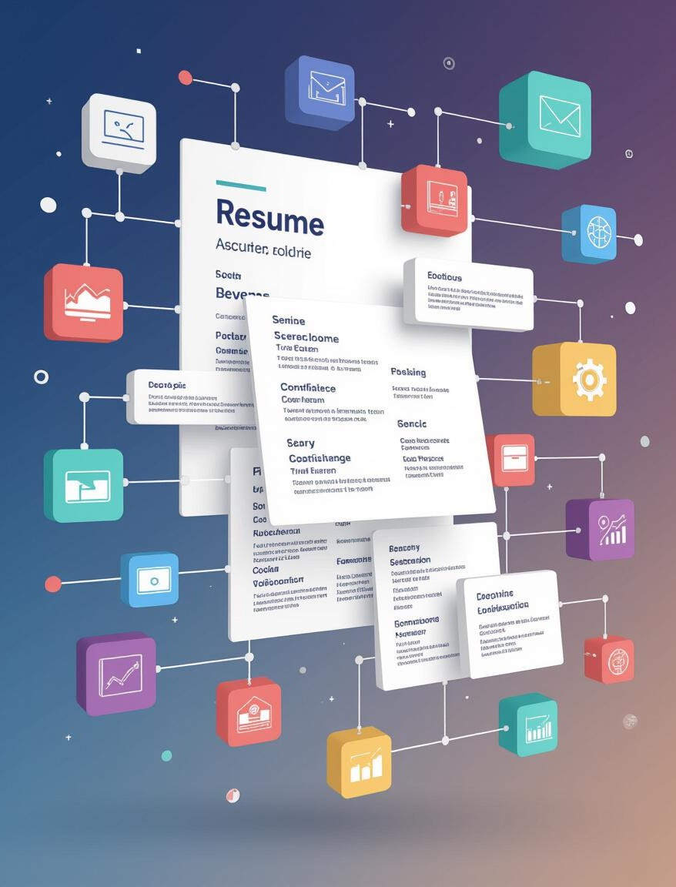
Technical Architecture & API Design
Overview:
System Architecture:
Secure RESTful APIs: Enables seamless integration with existing HR systems.
AI/ML modules: Uses advanced NLP, entity extraction, and skill inference.
OCR and validation layer: Ensures accurate file handling and protects against malware.
API Design:
Upload endpoint: Accepts resumes in various formats.
Status endpoint: Provides real-time processing status.
Parsed data retrieval: Returns structured resume data in JSON
format.

Slide 5

Impact & Future Enhancements
Overview:
Project Outcomes:
Faster hiring processes: Reduces time-to-hire significantly. Better candidate matching: Improves the quality of candidate selection. Scalable architecture: Handles large volumes of resumes efficiently.
Future Enhancements:
Multilingual parsing: Supports resumes in multiple languages.
Recruiter dashboard: Provides a user-friendly interface for recruiters.
Analytics integration: Offers insights into hiring trends and candidate
pools.
Revolutionizing recruitment with AI!

